Slide 1

20104079 Kalpesh Chavan
20104111 Siddhant Darekar
20104082 Ankit Awade
Project Guide
Prof. Roshna Sangle

Slide 2


Topic : URCorporator
- Mini Project (2A)

Slide 3

Contents
Introduction
Objectives
Scope
Features / Functionality
Project Outcomes
Technology Stack

Slide 4

1. Introduction
Problem Identified:
- Fake News Scams
- Poor Policing
- Lack of freedom to speak
- Political Arrogance
• Solution Proposed:
- The convenience
- Access anytime (24/7)
- Genuine News Source
- Save your efforts
- Political Information

Slide 5

2. Objectives
To build a bridge between citizens and government
To empower people to connect with the government and contribute towards good governance
To drive behavioral change, fighting fake news and busting myths
To introduce various government schemes and programs for the people

Slide 6

3. Scope
To provide users, facility to make complaint with any device
To provide users to check status of their grievances
To reduce user's time by just uploading photo
To provide user the SMS facility to acknowledge user's
To provide user a user friendly environment
To provide a delete complaint facility for corporator (for fake news)

Slide 7

4. Feature/Functionality
Help or Feedback Column
-If any customer has issue regarding quality of service etc. can contact us on help or feedback Column
Latest News
-We provide our user with latest news regarding any government policies, schemes etc.

Slide 8

5. Outcome of Project
Users can login/register
User will able to file a Complaint by posting a picture
After attending the request/complaint
of users they will receive a notification on
task completion
Users will be aware of overall development of their respective constituency/ward

Slide 9




6. Technology Stack
Web application built on

Slide 10
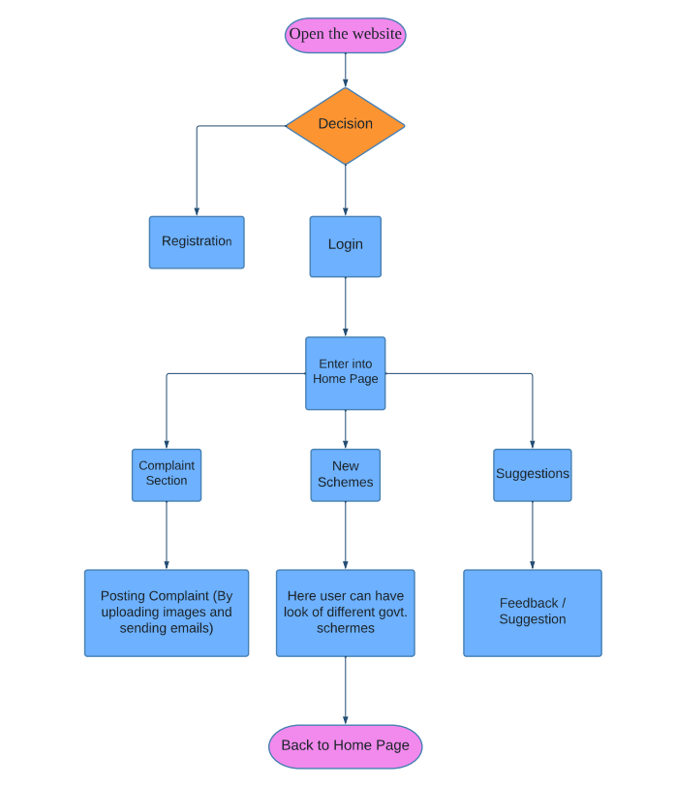

6. Block Diagram

Slide 11


